Slide 1
WEATHER EQUIPMENT

Slide 2
Section 4 Forecasting the Weather
Objectives
Describe the different types of instruments used to take weather measurements.
Explain how radar and weather satellites help meteorologists forecast the weather.
Explain how to interpret a weather map.


Slide 3
Weather tools
Meteorologists use many different tools to help them forecast the weather.
A weather forecast is a prediction of weather conditions over the next few days.
Meteorologists make weather forecasts using information on atmospheric conditions.

Slide 4
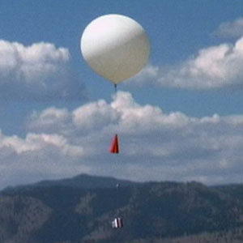
WEATHER BALLOONS
Weather balloons carry electronic equipment.
The equipment on a weather balloon can measure weather conditions as high as 20 miles above Earth’s surface.
This equipment measures temperature, air pressure, and relative humidity.
It transmits the information to meteorologists using radio signals.
Meteorologists can track the path of the balloons to measure wind speed and direction.

Slide 5
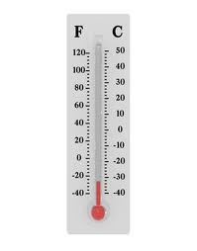
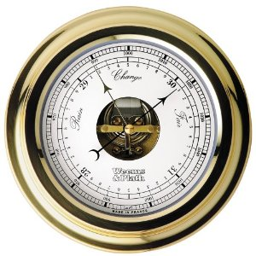
THERMOMETERS AND BAROMETERS
Measuring Air Temperature A tool used to measure air temperature is called a thermometer.
Measuring Air Pressure An instrument used to measure air pressure is a barometer.

Slide 6
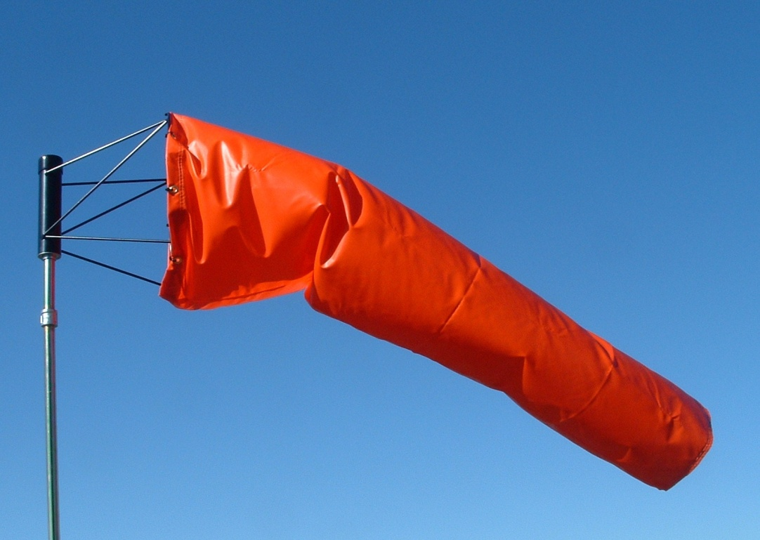
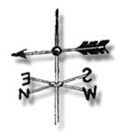
Measuring Wind Direction Wind direction can be measured by using a windsock or a wind vane.


Slide 7
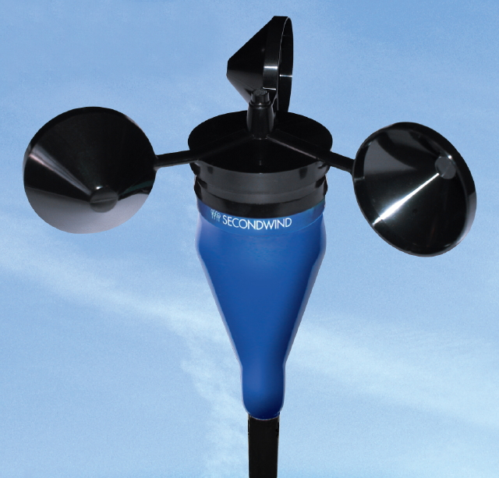
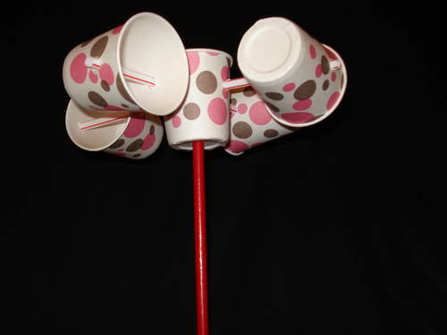
Measuring Wind Speed An instrument used to measure wind speed is called an anemometer.
It has three or four cups connected to a pole with spokes. The wind pushes on the open sides of the cups. This makes them spin on the pole. The spinning of the pole produces an
electric current, which is displayed on a dial. The faster
the wind speed, the stronger the electric current, and the
further the dial moves.


Slide 8
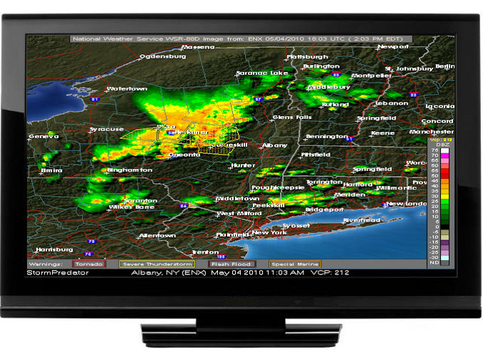
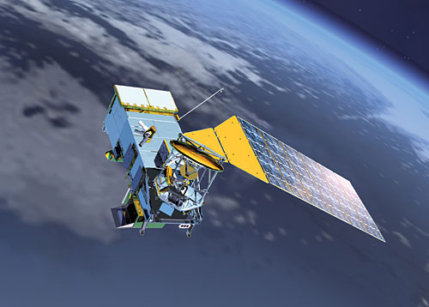
Radar and Satellites Radar is used to find the location, movement, and amount of precipitation. Weather satellites that orbit Earth provide images of weather systems.


Slide 9
Radar and Satellites Radar
Radar is used to find the location, movement, and amount of precipitation.
Most television stations use radar to give information about weather systems.

Slide 10
Weather satellites
Weather satellites orbiting Earth produce images of weather systems.
Satellites can also measure wind speeds, humidity, and temperatures from different altitudes.
Meteorologists use
weather satellites to
track storms.

Slide 11
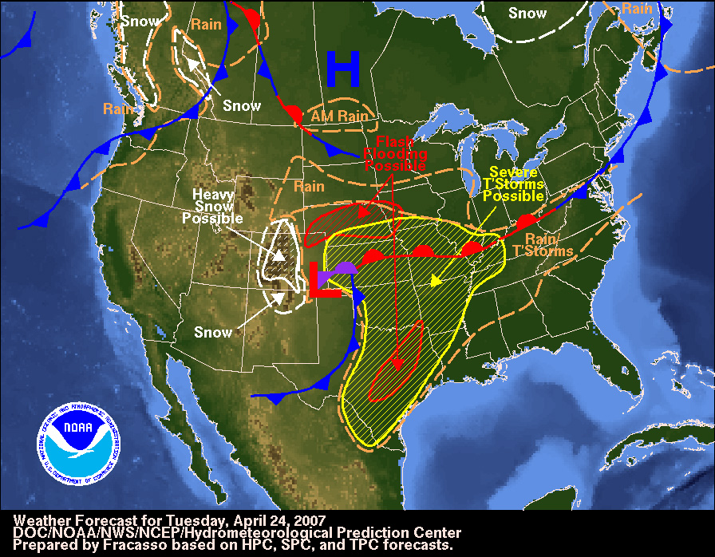
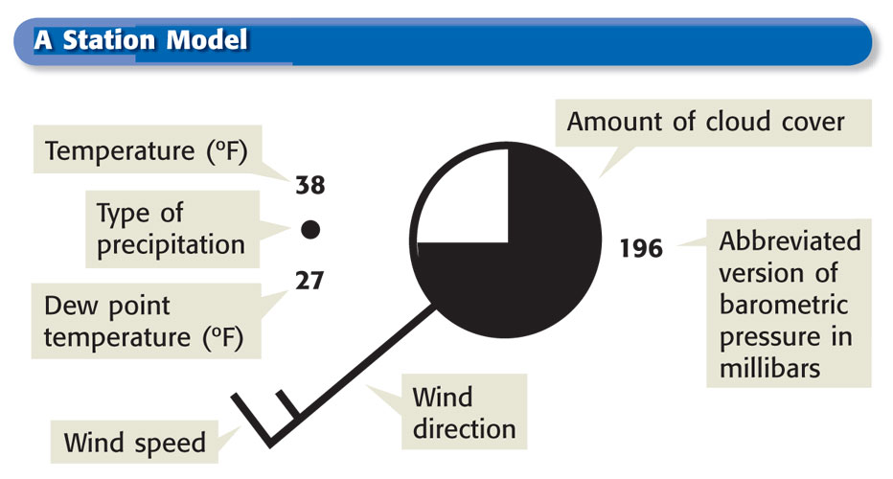
Section 4 Forecasting the Weather
Weather Maps
Who Makes the Maps?? The National Weather Service produces weather maps based on information gathered from about 1,000 weather stations across the United States.


Slide 12
Fist to Five
How do you feel about
weather tools?
Fist…What are we talking about?
Five….I got this!!!

Slide 13
How to read a Barometer
The main use for a barometer is not so much to read pressure, but to measure CHANGES in pressure over time. The Barometer normally has two needles, the measuring hand that displays the current pressure and the movable needle called the setting hand.
***You normally would align the setting hand directly over the measuring hand and then be able to see how much the measuring hand has moved during the day to indicate an increasing or deceasing pressure reading.

Slide 14
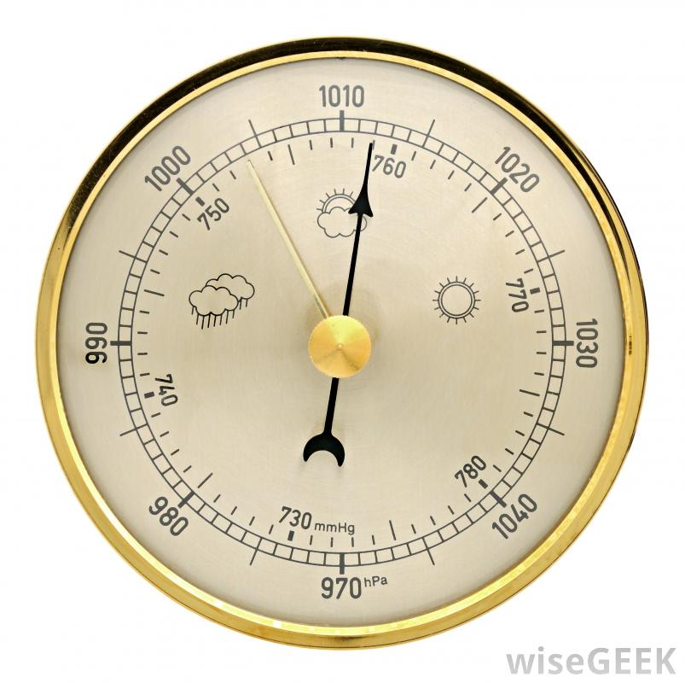
Measuring Hand
Setting Hand

Slide 15
Changing Pressure
A rising barometer = increasing air pressure.
This usually means:
Rising barometer readings indicate that a high pressure system is approaching. Higher atmospheric pressure is usually associated with fair weather and clearing skies.
Notes:
Rising barometer readings indicate that a high pressure system is approaching. Higher atmospheric pressure is usually associated with fair weather and clearing skies.

Slide 16
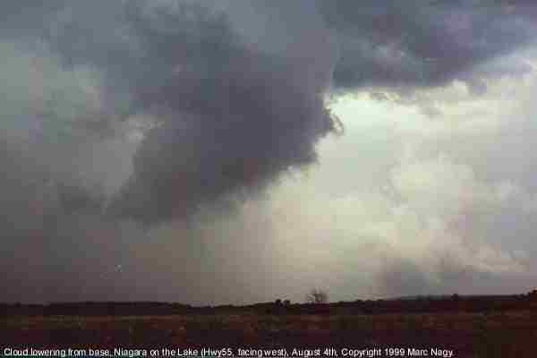
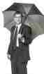
Changing Pressure
A falling barometer = decreasing air pressure.
This usually means:
Falling barometer readings usually indicate the approach of an area of low pressure. Low pressure readings are usually associated with storm systems. Tornadoes and hurricanes can produce very low barometric readings.
Notes:
Falling barometer readings usually indicate the approach of an area of low pressure. Low pressure readings are usually associated with storm systems. Tornadoes and hurricanes can produce very low barometric readings.

Slide 17
Let’s Practice!

Slide 18
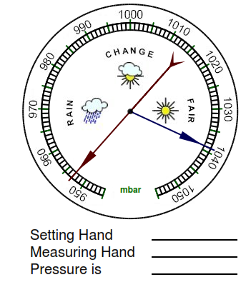
And the weather is???

Slide 19
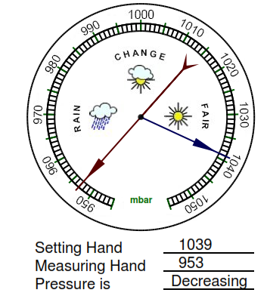
And the weather is???
Stormy

Slide 20
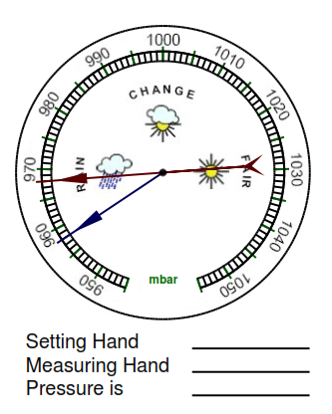
And the weather is???

Slide 21
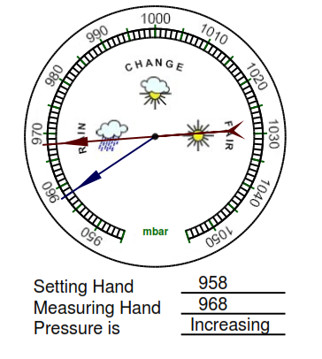
And the weather is???
Improving

Slide 22
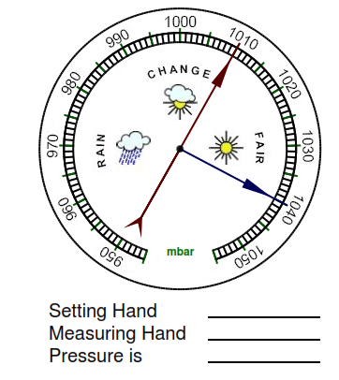
And the weather is???

Slide 23
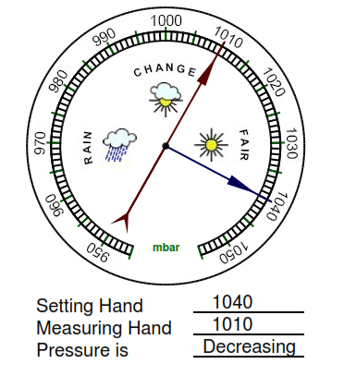
And the weather is???
Rain approaching

Slide 24
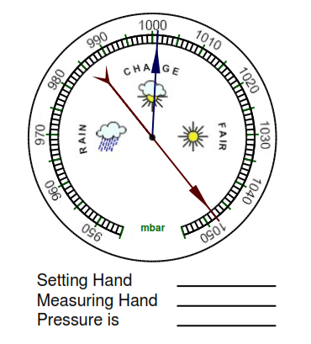
And the weather is???

Slide 25
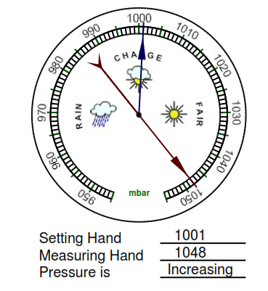
And the weather is???
Nice and Sunny

Slide 26
You will now work with your partner to calculate air pressure using a barometer.

